Slide 1
STRATEGIC PLANNING

Slide 2
OKRA-SPORT
OKRA-SPORT is the sport federation of OKRA, recognised and subsidised by the Flemish government.
OKRA has 1.159 local clubs and 206.585 members. It’s the biggest organisation for 55+ in Flanders.
903 of these clubs are affiliated with OKRA-SPORT with 47.500 sporting members.
Seniors are not only participants, they also guide the activities.

Slide 3
Strategic Planning 5 main tasks
Strategic planning for 4 years - Year Action Plans
Organizing sportactivities
Organizing education
Guiding sportclubs
Informing clubs and members
Promoting sportactivities

Slide 4
METHOD
Data collection: facts – inventarisation and evaluation – results of analyses
Conclusions
Strategic and operational objectives for the next 4 years
Year Action Plan: strategic and operational objectives for the coming year

Slide 5


TRANSLATION IN PROJECTS

Slide 6
FACT
Research has shown that more than half of the 55-plussers haven’t enough physical activity to be healthy and to age actively.

Slide 7
I. ORGANIZING ACTIVITIES

Slide 8
EVERY STEP COUNTS: 2009 - 2010
Sensibilisation campaign that encourages to have more physical activity.
walking → pedometer
Personal goal in 10 weeks
→ health benefits
Training schedules by KULeuven
Community project

Slide 9
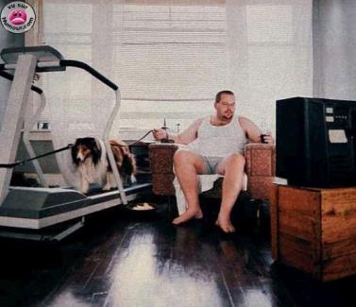
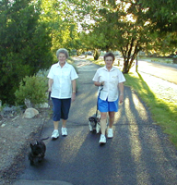
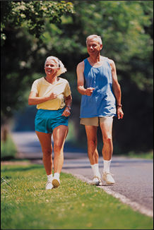
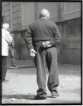
TARGET GROUP?
3
2
4
4

Slide 10
RESULTS
Every step counts
394 participating clubs
20 residential care centres
7000 participants of which 2000 sedentary people

Slide 11
EVERY PEDAL COUNTS 2011 - 2012
Same model
With attention for the sedentary people
Program for home exercise machine
Possibility to rent / buy an electrical bike
3671 participants (928 sedentary people)
122 clubs
46 residential care centre

Slide 12
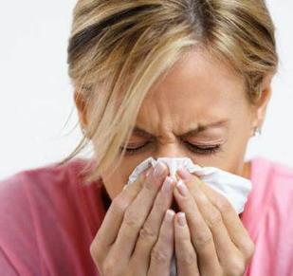
II. ORGANIZING EDUCATION
PEEREDUCATION
LOCAL IMPLEMENTATION
TRAIN THE TRAINER:
The importance of physical exercise
Technical education
‘It’s OK to infect the others’

Slide 13
III. GUIDING SPORTCLUBS
Walking Box – Cycling Box
Description and material for the test to determinate the beginning level
Training programs for the participants
Specific materials: pedometers – bicycle helmets …

Slide 14
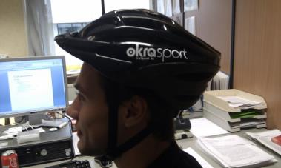
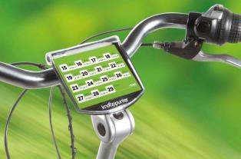

Slide 15
IV. INFORMING CLUBS AND MEMBERS
Information about the importance of physical activity to be healthy and to age actively
Presentation ' exercise more for a better life '
Articles in our magazine for the members
Face to face conversations

Slide 16
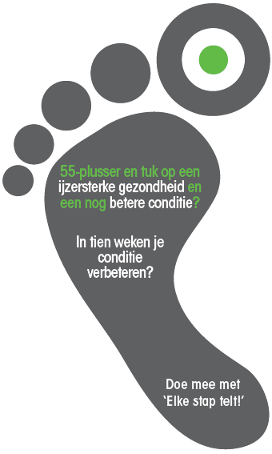
V. PROMOTION
Face to face
Website and newsletter
Magazine
Flyers on public places

Slide 17
THANKS FOR YOUR ATTENTION!

