Slide 1
Keeping the elderly active
Ideas – beliefs - challenges

Slide 2


Ideas and beliefs
Concrete projects:
  Individual starting point
  Personal program during a well defined period
  In a social setting guided by peers
  Personal goal

Slide 3
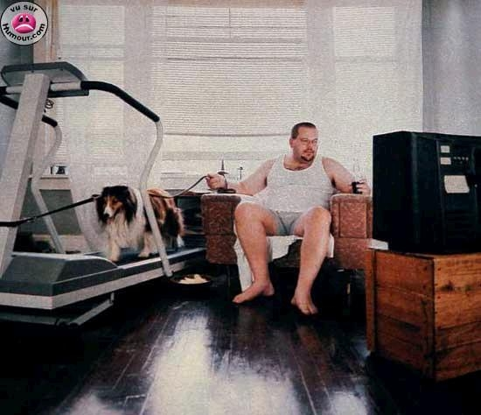
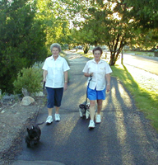

Slide 4

Ideas and beliefs
How? Thinking ‘out of the box’!

Slide 5
Ideas and beliefs
Coming to new challenging settings
Move Transfer:
Every step
counts in
prison

Slide 6

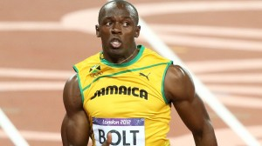
Challenges
How to motivate inactive elderly people?
Importance of peer education!

Slide 7
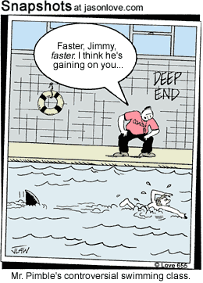
Challenges
From ‘mustivation’ to motivation
Education of ambassadors of Movement
Method ABC
  Autonomy
  Belonging
  Competence

Slide 8

Challenges
Developing new projects together with experts and volunteers
Exchanging experiences with other organisations in Europe → Moving Age Platform

Slide 9
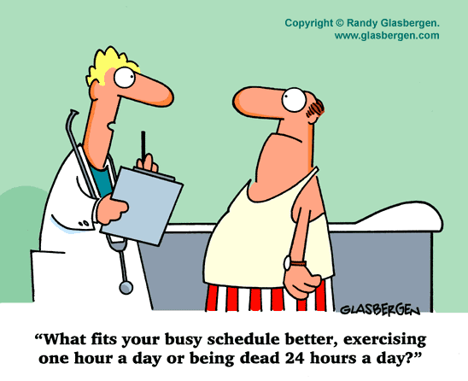
THANKS FOR YOUR ATTENTION

