Slide 1

Experiences and innovative plans

Slide 2
Who we are
OKRA-SPORT+ is the sport federation of OKRA, recognised and subsidised by the Flemish government.
OKRA has 1.159 local clubs and 206.585 members. It’s the biggest organisation for 55+ in Flanders.
903 of these clubs are affiliated with OKRA-SPORT+ with 47.000 sporting members.
Seniors are not only participants, they also guide the activities.

Slide 3
What we do
Strategic planning for 4 years - Year Action Plans
Organizing sportactivities: local – regional - national
Organizing education: train the trainers
Guiding sportclubs
Informing clubs and members
Promoting sportactivities
Coöperate and exchange experiences

Slide 4
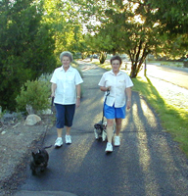
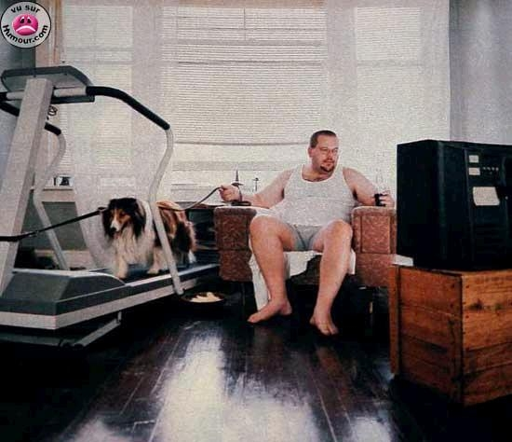
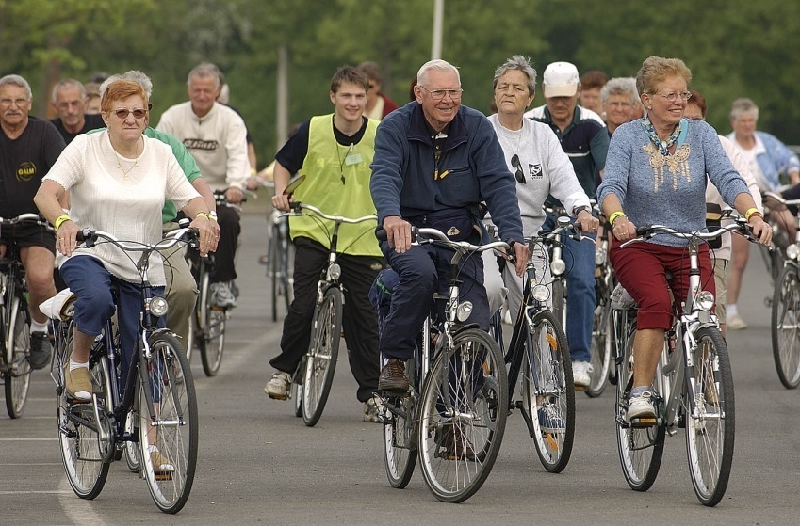
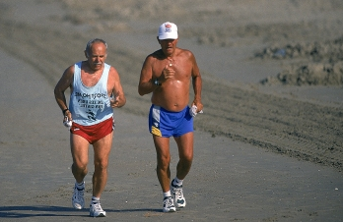
Seniors, a diverse group!

Slide 5

Physical Inactive
Not aware of the importance
Often oldest elderly people:
No participation chances in the past!
Image: retire = rest
Hard to reach but important group!

Slide 6

Physical active in daily activities
Functional
Alone or with partner or a friend
Risk: change in their life can lead to inactivity!

Slide 7
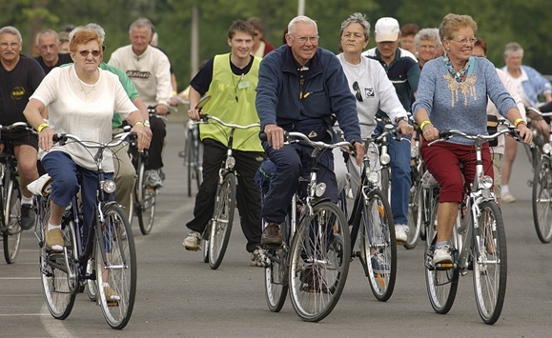
Joining sportactivities
OKRA: elderly organization
1.100 local clubs: organizing all kinds of activities: daytrips – card playing – academies …
930 clubs
OKRA-SPORT+: sportfederation
Stimulating and facilitating organizing sportactivities: cycling – hiking – gym – dance …

Slide 8
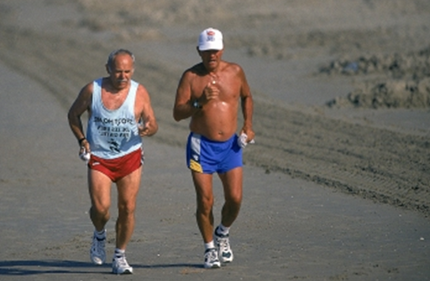
Life time sporters
Very motivated!
In sportclubs or individual

Slide 9
A diverse group → a diverse approach
How to reach and motivate them
Programs
Providers and partners

Slide 10
How to reach and motivate them
Personal approach
Easy talk coming slowly to the message
Importance of peer education

Slide 11
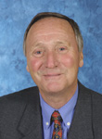
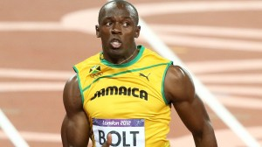
How to reach and motivate them
Importance of peer education!

Slide 12
How to reach and motivate them
Inviting them to join an event
Convince them that joining sport activities in group has an extra dimension

Slide 13
How to reach and motivate them
They are allready motivated!
Keep them interested by organising varieties in activities

Slide 14

How to reach and motivate them
Very motivated
Ask them to be a trainer or supervisor of sportactivities for their peers.

Slide 15
Programs
Concrete projects:
Individual starting point
Personal program during a well defined period
In a social setting guided by peers
Personal goal

Slide 16


Concrete projects

Slide 17
Concrete projects
Success factors
Short term: 10 à 12 weeks
Concrete program
Individual programs: several starting levels → fits all the groups!
Once a week in group: social pressure!
Motivating materials: Pedometer – box with week programs - …
Peer education

Slide 18

Programs
Events with low barrier activities

Slide 19
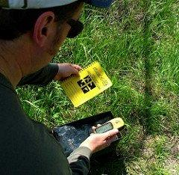
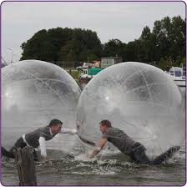
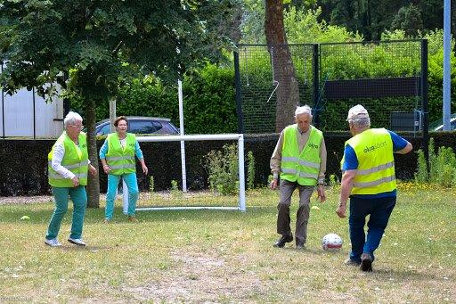
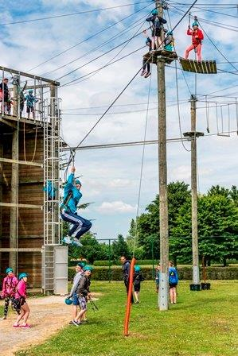

Slide 20
Programs
Challenging activities
Competition
Education to be a trainer or supervisor for sportactivities for their peers

Slide 21
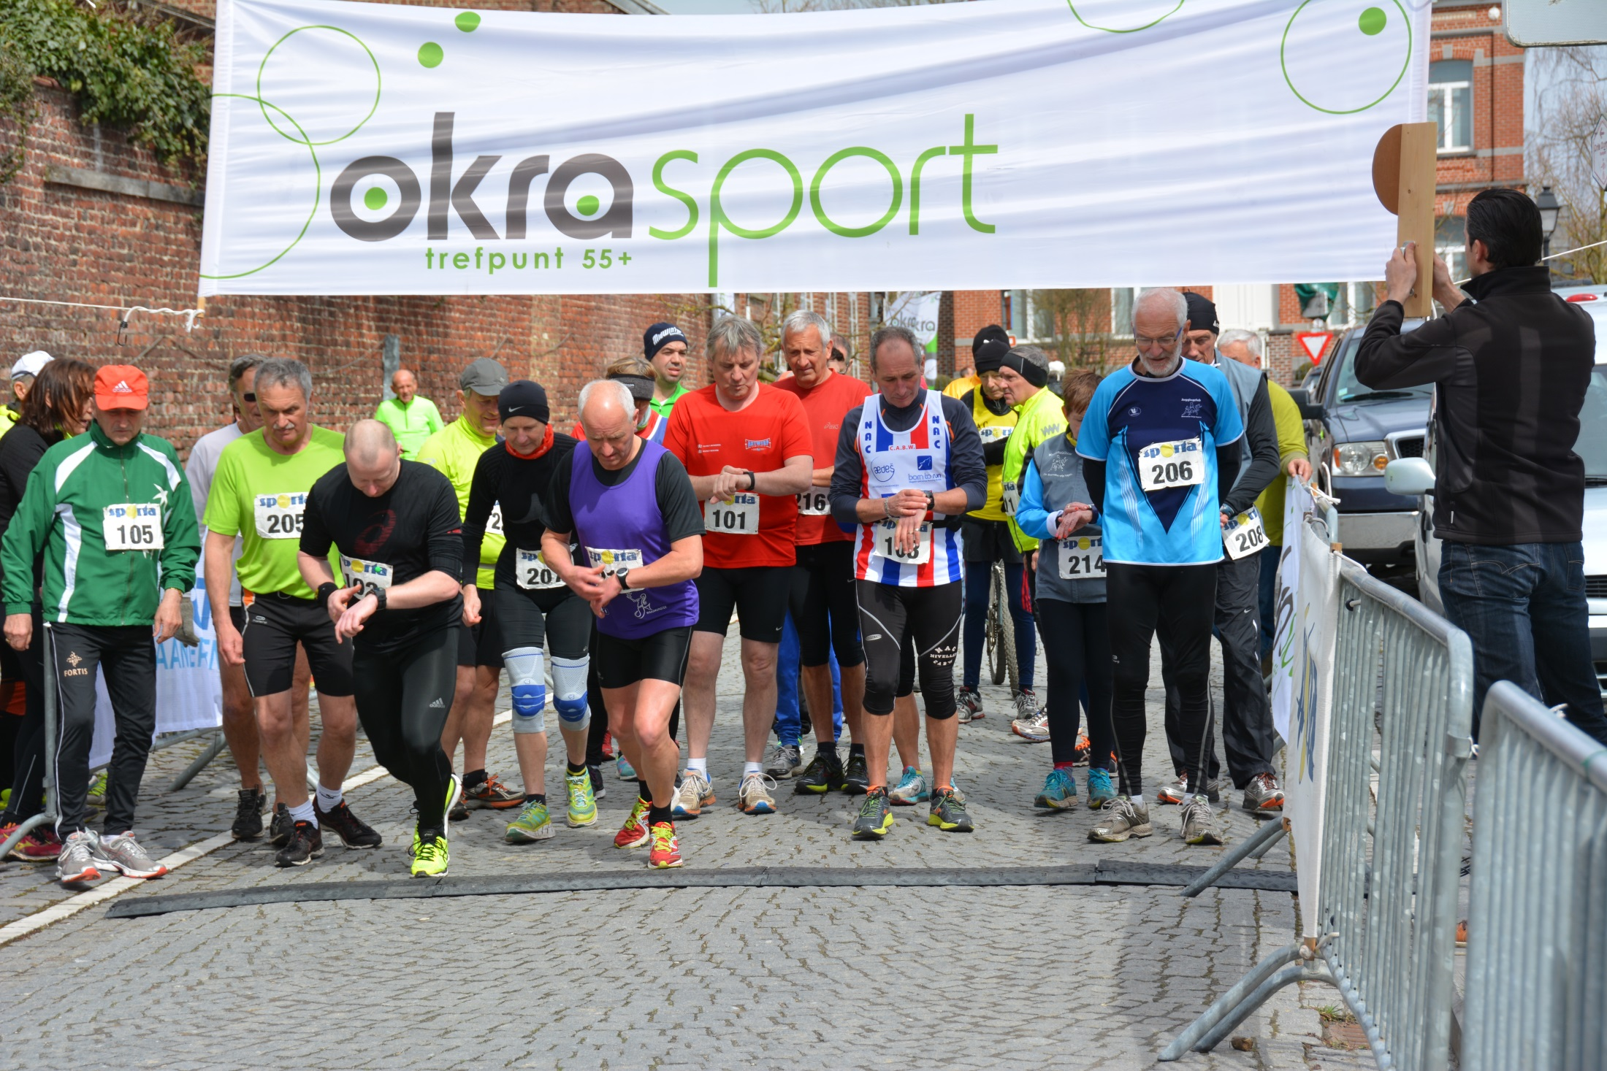

Slide 22

Providers and partners
Work together with health providers
Work together with
elderly organisations

Slide 23
Providers and partners
Keep them in your club!
Adapt your activities

Slide 24
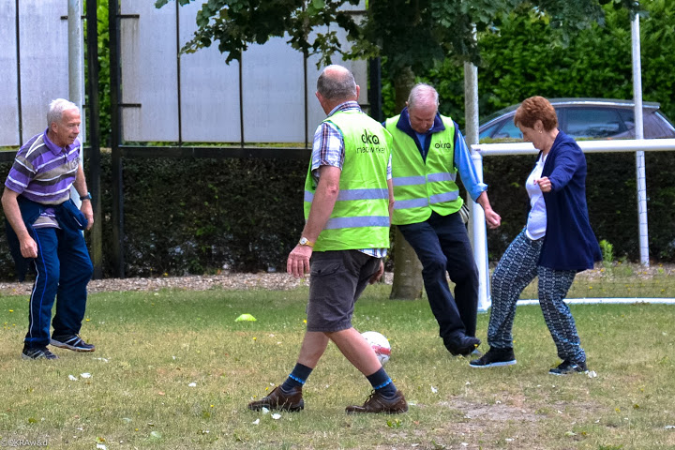
Adapt your activities

Slide 25

Coming soon! New project
Project concerning:
- Movement:
Program to gain strength
Every step counts
Nutrition
Breaking sedentarial behavior
Individual and in group
12 weeks
Peer education

Slide 26
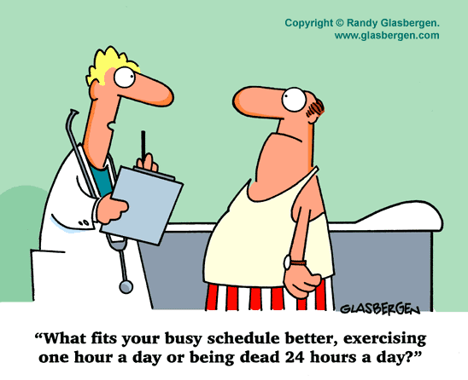
THANKS FOR YOUR ATTENTION

